Slide 1
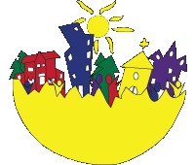
Asset-based Community Development

Slide 2
Key Messages
Two Solutions, Two Paths
Local Commitment and Resources
Community-building Path
Asset-based
Internally Focused
Relationship Driven

Slide 3
Primary Components
Releasing Individual Capacities
Releasing the Power of Local Associations and Organizations
Capturing Local Institutions for Community Building
Rebuilding the Community Economy
Mobilizing an Entire Community

Slide 4
Releasing Individual Capacities
Youth
Seniors
People with Disabilities
People Living in Poverty
Artists

Slide 5
Releasing Local Organizations
Religious Institutions
Cultural Organizations

Slide 6
Capturing Local Institutions
Parks
Libraries
Schools
Community Colleges
Police
Hospitals

Slide 7
Rebuilding the Community Economy
Local Purchasing
Hiring Locally
Creating New Businesses
Developing Human Resource Potential
Local Investing
Economic Bridge Building
Commitment to Communit

Slide 8
Mobilizing an Entire Community
Capacities of Individuals
Gifts of Strangers
Associations of Citizens
Local, Private, Public and Non-Profit Institutions
Community’s Physical Assets
Capacity Finders and Developers

Slide 9
5 Steps Towards Whole Community Mobilization
Step 1 - Mapping Assets
Step 2 - Building Relationships
Step 3 - Mobilizing Community Assets
Step 4 - Convening Broadly Representative Group
Step 5 - Leveraging Outside Resources

Slide 10
Case Study
Step 1 – Mapping Assets

Slide 12
Our Niche!

Slide 13
Case Study
Step 1 - Mapping Assets
Step 2 - Building Relationships

Slide 14
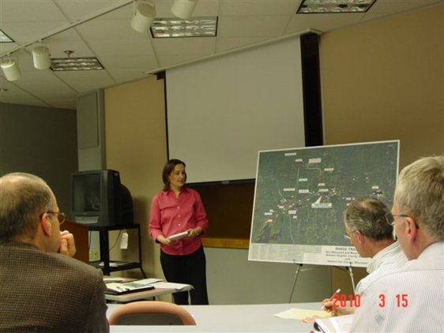
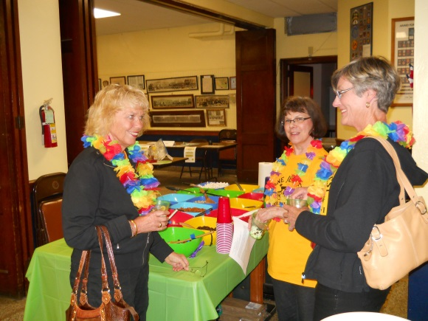
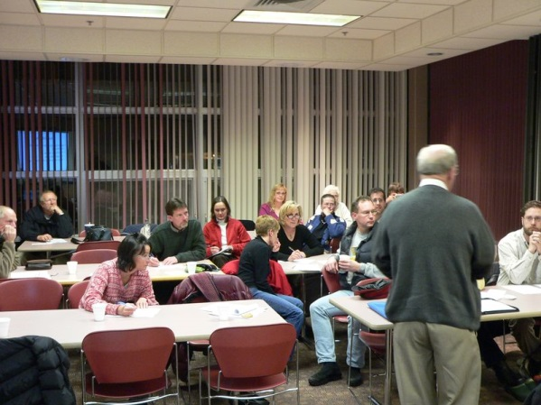
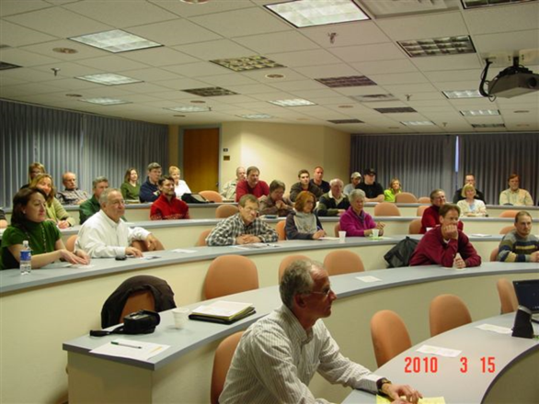
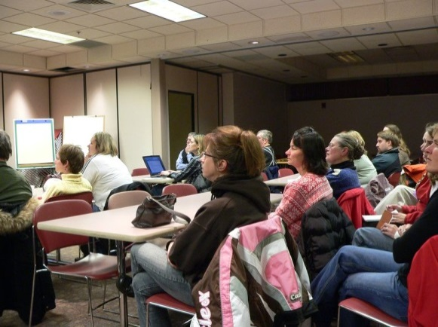
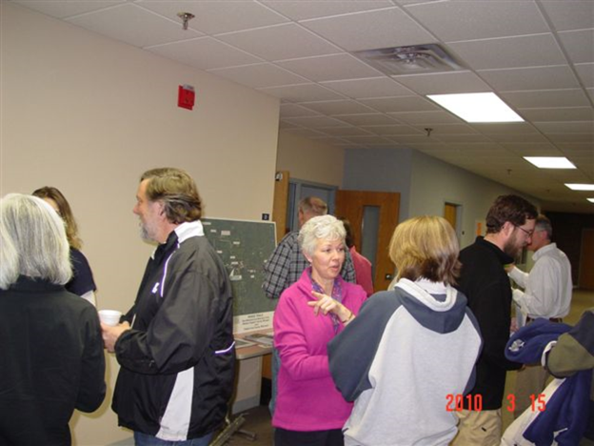
Building Relationships

Slide 15
Case Study
Step 1 - Mapping Assets
Step 2 - Building Relationships
Step 3 - Mobilizing Community Assets

Slide 16
Mobilizing Community Assets
Iron County Board of Supervisors
Iron County Forestry and Parks Committee
Iron County Resource Development Association, Inc.
City of Hurley
Hurley Area Chamber of Commerce
Hurley School District
City of Montreal
Town of Kimball
Gogebic County Board of Commissioners
Gogebic County Economic Development Commission
Ironwood City Commission
Ironwood Parks and Recreation Committee
Ironwood Area Chamber of Commerce
Ironwood Area School District
Ironwood Charter Township
Erwin Township
City of Bessemer
Bessemer Downtown Development Authority
Bessemer Chamber of Commerce
Bessemer Area School District
Bessemer Township
City of Wakefield
Wakefield Planning Commission
Wakefield Chamber of Commerce
Wakefield-Marenisco School District
Wakefield Township
Marenisco Township Board
Grand View Health System
Gogebic Community College
Western Upper Peninsula Convention and Visitors Bureau
Ni-Miikanaake Chapter of the North Country Trail Association
Michigan Department of Natural Resources and Environment (letter of support)
Upper Peninsula Travel and Recreation Association
U.S. Forest Service (letter of support)
International Mountain Biking Association (letter of support)

Slide 17
Case Study
Step 1 - Mapping Assets
Step 2 - Building Relationships
Step 3 - Mobilizing Community Assets
Step 4 - Convening Broadly Representative Group

Slide 18
Convening Broadly Representative Group(s)
Promoting Our Strengths Workgroup
Railroad Technical Working Group
Regional Trail Authority
Riverside Trail Committee

Slide 19
Case Study
Step 1 - Mapping Assets
Step 2 - Building Relationships
Step 3 - Mobilizing Community Assets
Step 4 - Convening Broadly Representative Group
Step 5 - Leveraging Outside Resources

Slide 20
Leveraging Outside Resources
Over $1.5 million in funding:
Acquisition of Trail Route
Depot Park Trail Head Completed
Ethnic Commons Trail Head Completed
Phase I Paved – Summer of 2014
Train Trestle Retrofitted – Summer of 2014
Phase II Grant Submitted (Local Match Acquired)

Slide 21
Supporting Literature
Community Capitals Framework
Community Organizing
Change Theory
Change Resistance

Slide 23
Action Research
Research
Action
Action
Research

Slide 24
Two Forms of Social Change
A More Participatory Society
Solving Local Problems

Slide 25
Power/Knowledge/Action
Power
Knowledge
Action
With regards to Michel Foucault

Slide 26
Change Theory

Slide 27
Change Resistance

Slide 28
ABCD Resources
Alinsky (1989). Rules for Radicals
Flora and Flora (2008). Rural Communities: Legacy and Change
Green and Haines (2008). Asset Building and Community Development
Kotter (1996). Leading Change
Kretzman and McNight (1993). Building Communities from the Inside Out: A Path Toward Finding and Mobilizing a Community's Assets
Krile (2008). The Community Leadership Handbook: Framing Ideas, Building Relationship, and Mobilizing Resources
Marshak (2006). Covert Processes at Work: Managing the Five Hidden Dimensions of Organizational Change
McKnight (2010). The Abundant Community: Awakening the Power of Families and Neighborhoods
Rappaport (1977). Community Psychology: Values, Research, and Action
Stoecker (2005). Research Methods for Community Change: A Project Based Approach

